Slide 1
The Technology Value Stream
Trevor McLaurine
WEB430 – Presentation 1.2

Slide 2
devOps and The value stream: an overview
DevOps is the combination of various principles to create a philosophy that strives on collaboration. Collaboration occurs when teams come together and work towards the same goals. These goals can be visualized by what is known as the Value Stream.

Slide 3
The value stream
The Value Stream, as described in the book Value Stream Mapping: How to Visualize Work and Align Leadership for Organizational Transformation, the sequence of activities required to design, produce, and deliver a good or service to a customer, including the dual flows of information and material.
Essentially, what this means is that the value stream visualizes what things are needed to be done in order to accomplish a goal for its’ customers. The following Slide shows an example of how these goals are imagined.

Slide 4
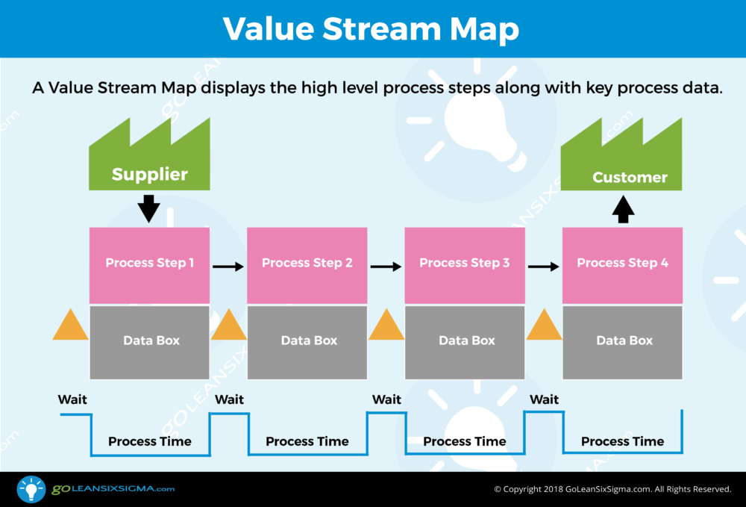
Value stream visualized

Slide 5
Lead times and processing time
Lead Time
Processing Time
Lead time is one of the measures commonly used for performance in a value stream. Lead Time begins when a request is made and ends when the request is fulfilled and put to production
Processing time is another measure used for value streams. However, processing time begins when the developer first begins working on the ticket and ends when the work is completed.

Slide 6

Importance of lead times
Lead times our how we measure our efficiency when dealing with various work items. It is important to measure these times to ensure that each item is taken care of in a reasonable manner.
Sadly, it is all too common that tickets or problems are not resolved in a reasonable manner.

Slide 7
Value stream and lead times
The Reality
The Ideal
Lead times are generally much longer than what is ideal. Most companies have an intricate network of testing, approval processes and other forms of red tape that can hold up a ticket for an exorbitant amount of time. This leads to frustrated developers and customers.
DevOps seeks to create a work environment that receives fast, constant feedback on work. This allows developers to quickly and independently integrate a fix for their code, test it and ship it to production. What would normally take months would now take minutes.

Slide 8
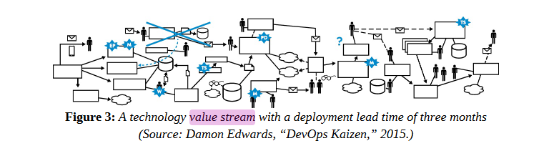
Why longer lead times?
Longer lead times can be a result of many different things. From bureaucratic red tape to a lack of organization in testing, lead times commonly take a very long time. If developers do not have a clear-cut way of testing and putting a fix into production, the result can be a chain of red tape that will take months to come to an end.

Slide 9
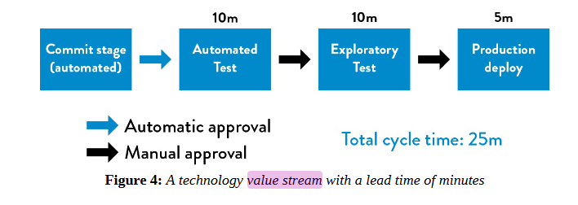
How to achieve this ideal
These lead times are achievable we consistently check small code changes into our version control system (such as Github), performing routine testing, and deploying it into production.
More importantly is the architecture of developers that perform these tests. Small teams can perform these tests at a rapid pace and create an ideal turnaround for each ticket.

Slide 10
Conclusion
DevOps can provide a clear and concise way to reduce lead times. By reducing the amount of red tape that can lead to a slow turnaround time and introducing an independent means of handling tickets, lead times can be reduced. Small teams of developers can work together to handle various bug fixes, or issues without the need of authorization. Thus, creating a better experience for developers and consumers alike.

